Slide 1
How to give a good demo
Framework Project 1
Ultimate career hacks 1

Slide 2
1 april
Frog in the behind

Slide 3


Slide 4
Assignment (30 min)
As a team, find another team to cooperate with
Both teams show the exact same demo (10 min) from last week
Split up again
Both teams try to answer internally (5 min):
What was the other team trying to do?
What do you think of the demo they gave? Was it good, bad? Why?
What feedback do you have for the team?
Plenary: explain answers per team (5 min)

Slide 5
The Demo commandments
Thou shall always start with the actual demo

Slide 6


Slide 7
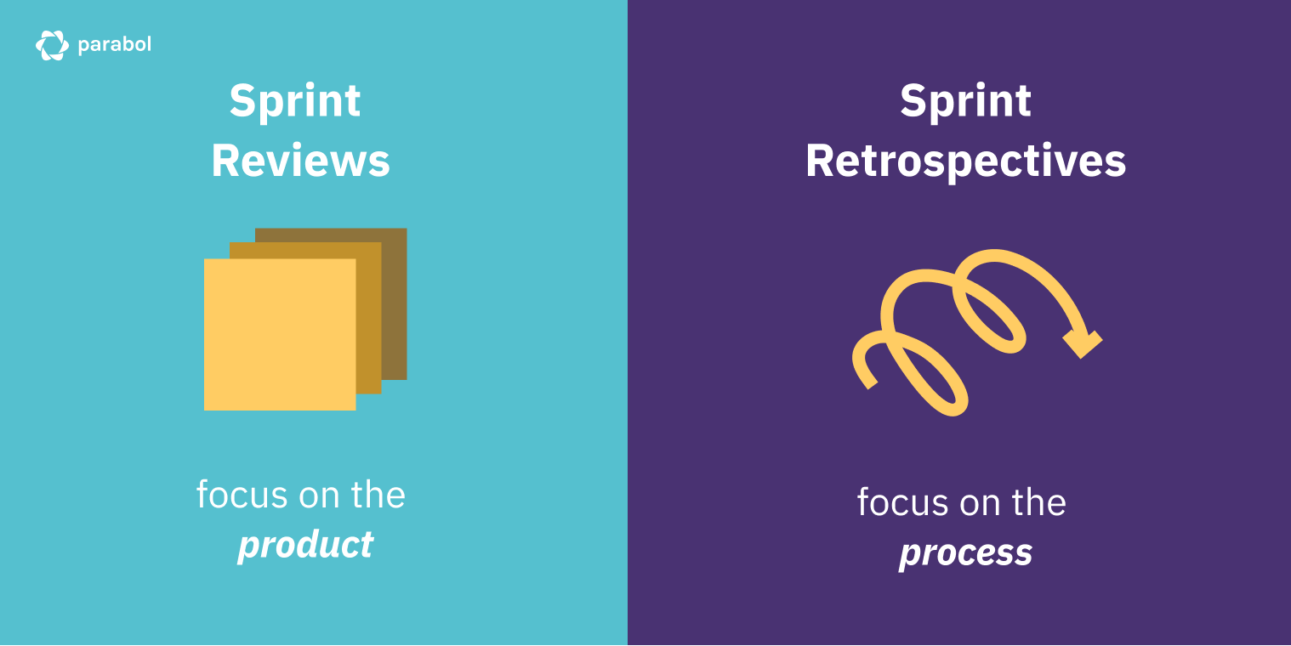

Slide 8
Pubquiz
When do you talk about the software process with the client?
You don’t
Whenever something went wrong and the client deserves an explanation
Whenever you’re talking with the client; more perspectives is better
In the retrospective

Slide 9
Pubquiz
When do you talk about the software process with the client?
You don’t
Whenever something went wrong and the client deserves an explanation
Whenever you’re talking with the client; more perspectives is better
In the retrospective

Slide 10

Pubquiz
When do you talk about the software process with the client?
You don’t
Whenever something went wrong and the client deserves an explanation
Whenever you’re talking with the client; more perspectives is better
In the retrospective

Slide 11
The Demo commandments
Thou shall always start with the actual demo
Thou shall rarely discuss the process with the client

Slide 12

Sprint demo
Focus on the product
Show only three things:
The product itself
Choices you have made and would like to validate
Choices that you cannot make and would like to discuss
How can you show those choices best?

Slide 13
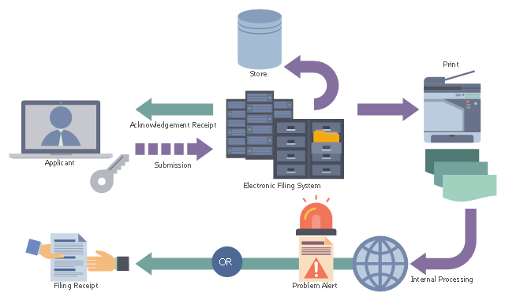
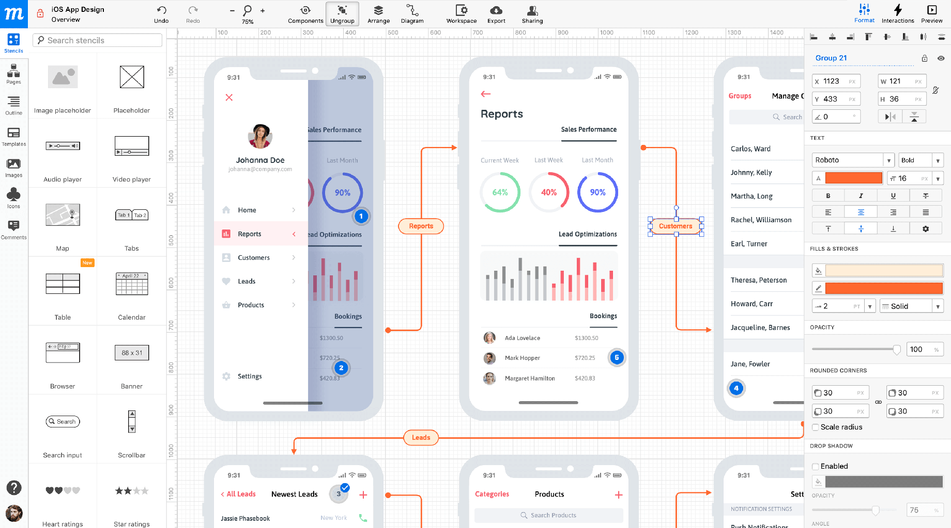
Graphics Prototypes

Slide 14
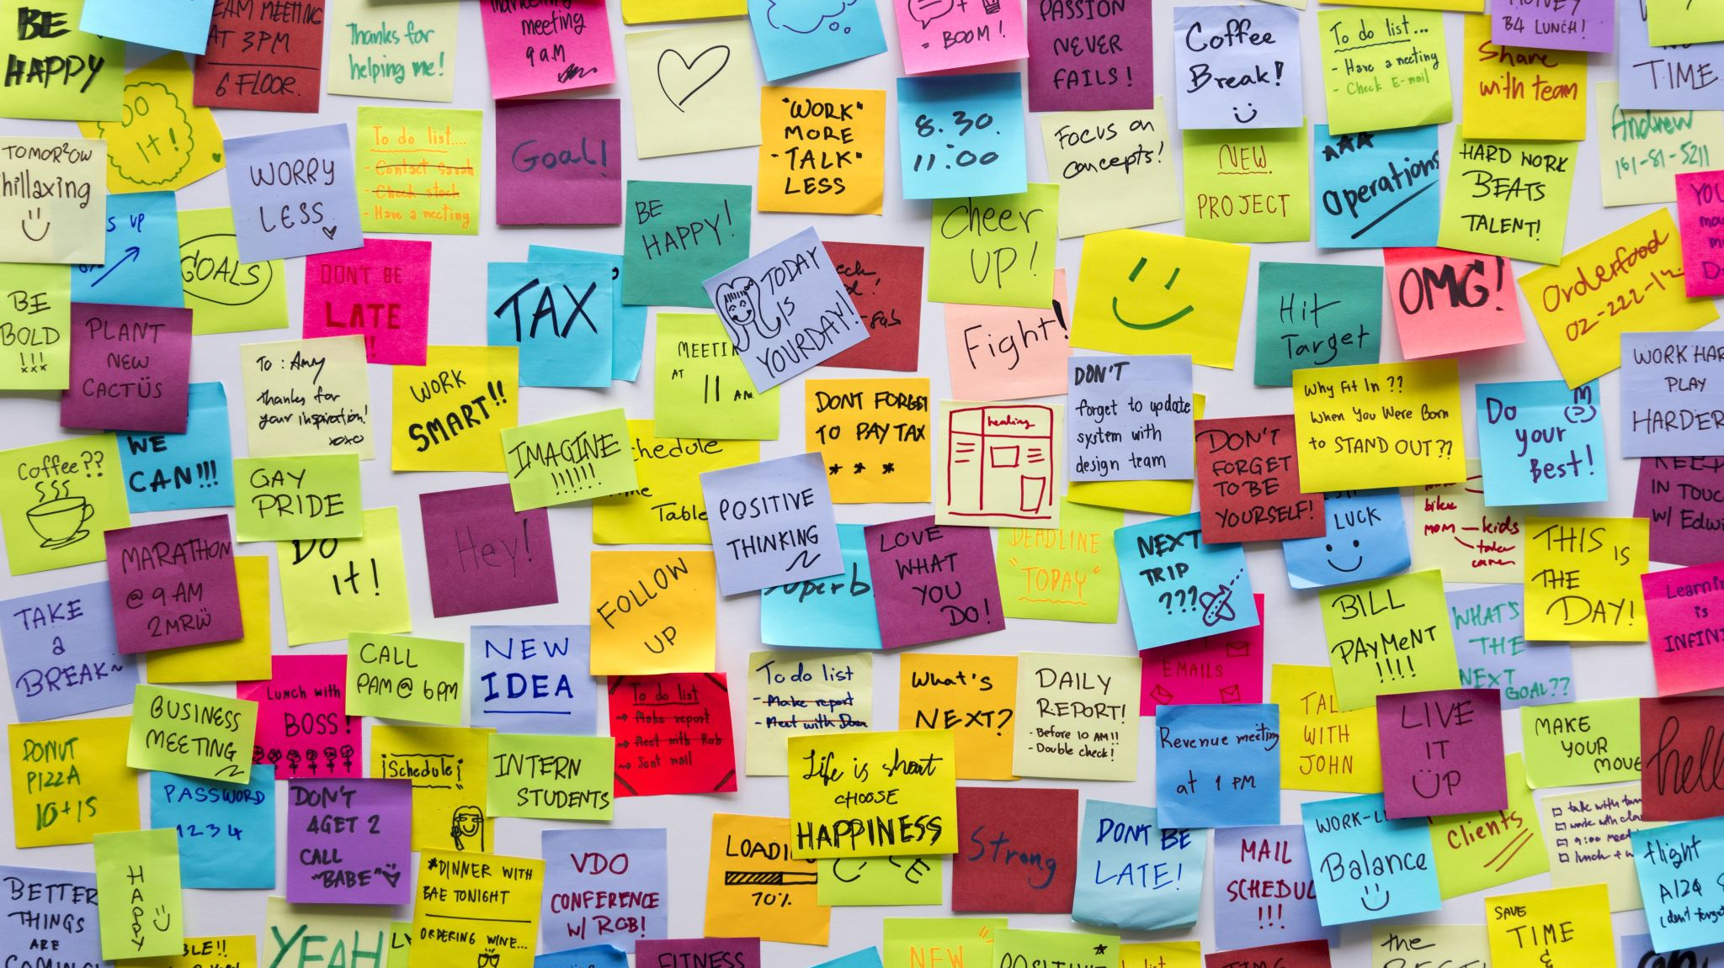
DEMOCEPTION
Actual demo now
I’m presenting the HZ schedule app in two ways
Both ways are commonly done by students

Slide 15
Assignment
Answer the following questions:
Which way of demoing was best?
Is that a good way of demoing?
What mistakes did I make?
What did I do well?

Slide 16

Demo 1
Team Loek

Slide 17
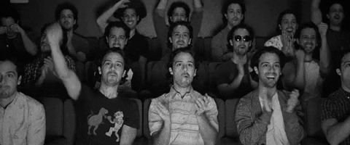
Demo
Notes:
Click through the app as quickly as possible without explaining anything well. Just saying WHAT you’re doing instead of WHY and WHEN you’re doing it. Oh and the obligatory “Now it is ugly but it will be pretty”

Slide 18

Questions?

Slide 19
Demo 2
Team Loek

Slide 20
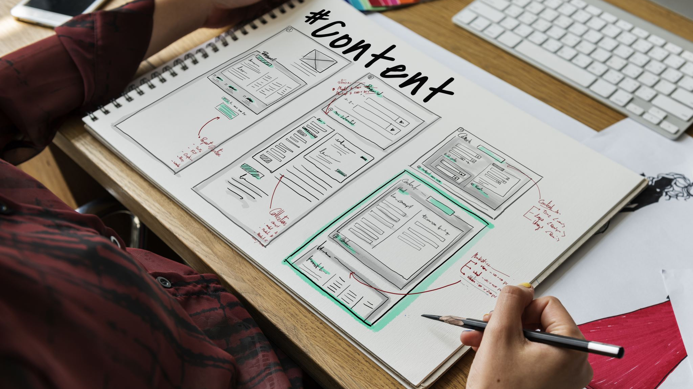
Agenda
Introduction
Sprint planning
Demo
Questions?

Slide 21

Project
HZ is client
Scheduling app does not work
It needs to be better
More efficient
Just more
GIVE IT ALL
Notes:
Hier het project uit gaan leggen, maar dan eigenlijk ook net niet zegmaar

Slide 22

Sprint
We work in sprints
Every two weeks a demo
Show the product
Notes:
Zoveel mogelijk jargon de klas inschieten. User stories, estimation, sprint planning, demo, daily standup, burndown chart, alles.

Slide 23
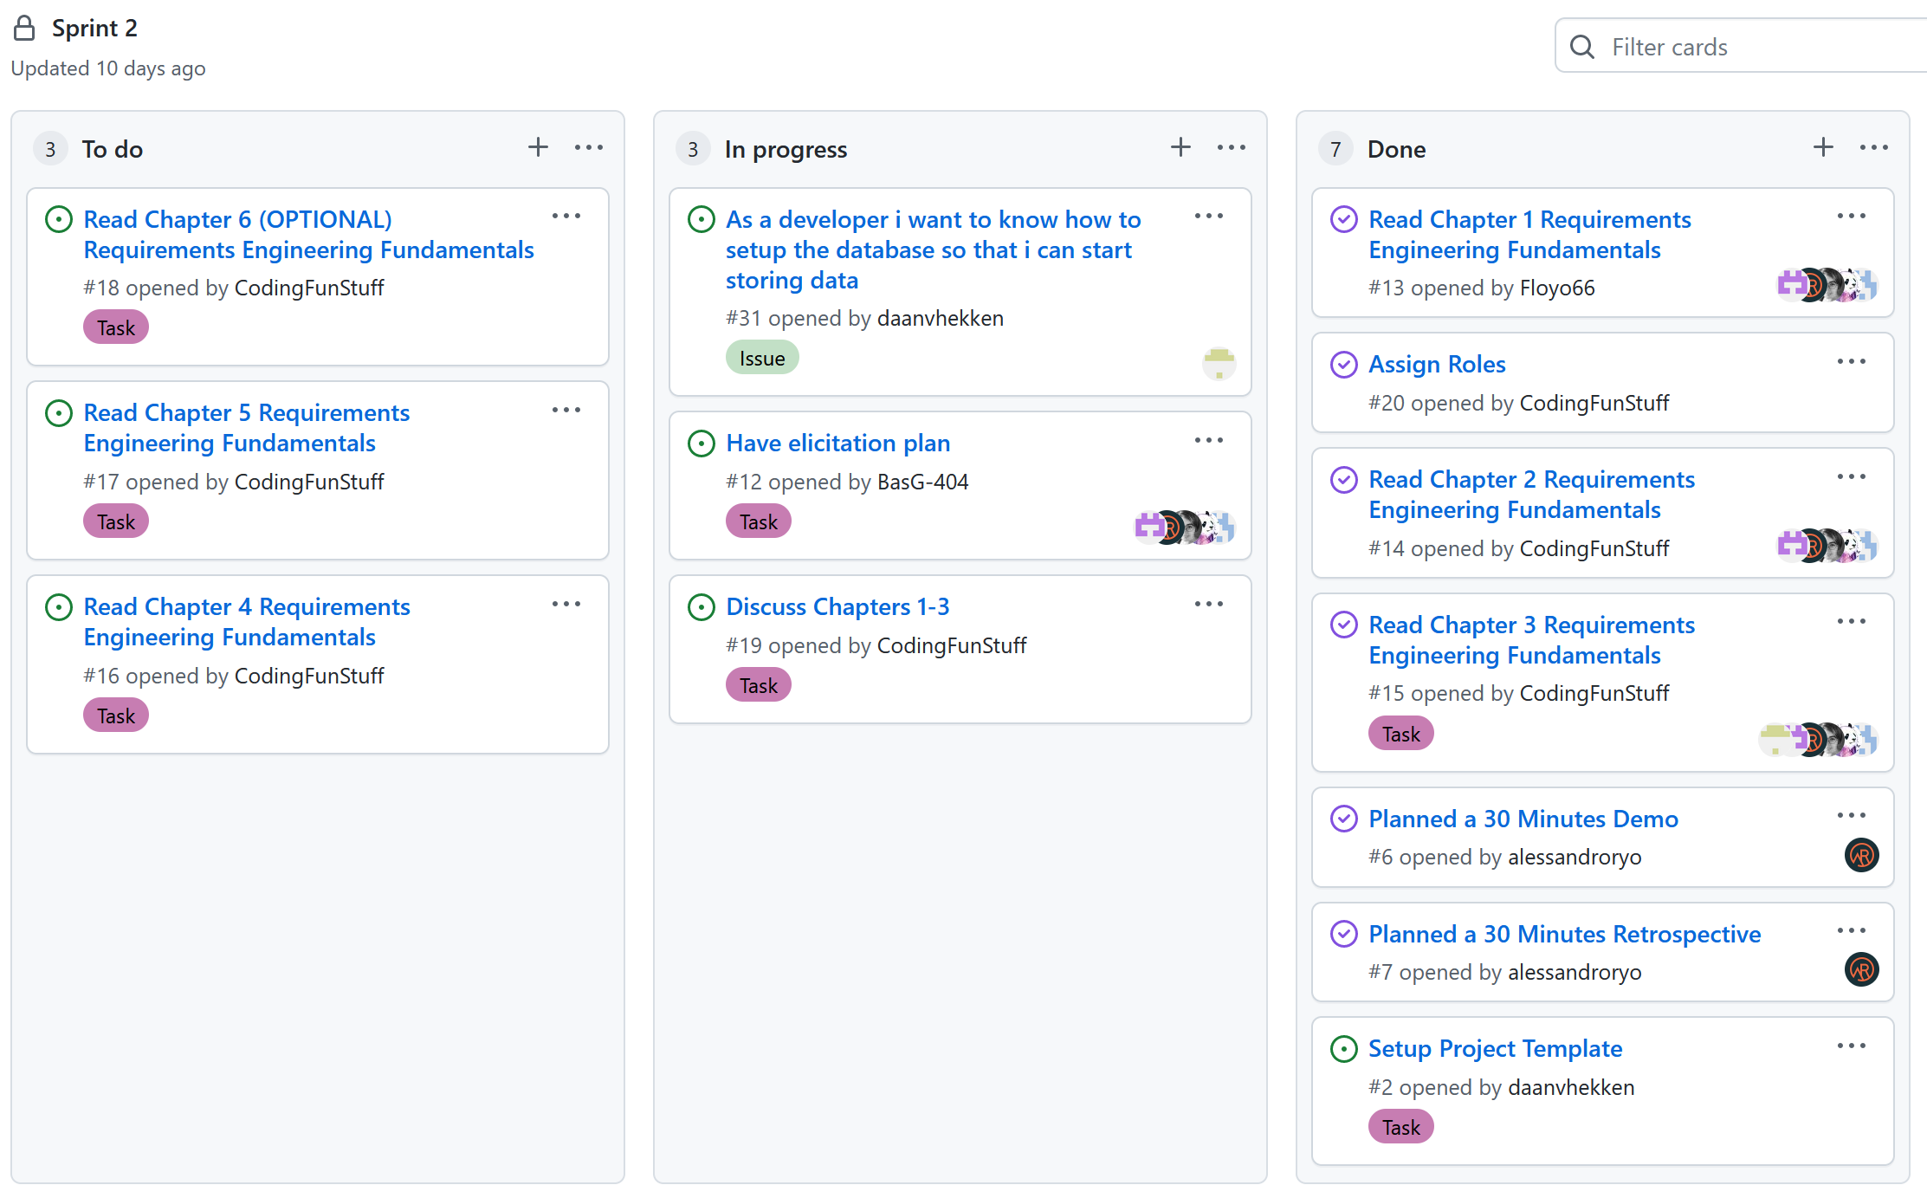
Sprint planning
Notes:
Random planning laten zien die half af is en dan zeggen “dat is gelukt”

Slide 24
DEMO
Notes:
Random iemand uit de klas aanwijzen “ja jij deed de demo toch? Ik heb hem niet kunnen pullen want ik moest gister naar de tandarts”

Slide 25
Questions?

Slide 26
Assignment
Answer the following questions:
Which way of demoing was best?
Is that a good way of demoing?
What mistakes did I make?
What did I do well?

Slide 27
The Demo commandments
Thou shall always start with the actual demo
Thou shall rarely discuss the process with the client
Thou shall always show thy sprint goals in terms the present stakeholder understandeth

Slide 28
Questions?

Slide 29
The Demo commandments
Thou shall always start with the actual demo
Thou shall rarely discuss the process with the client
Thou shall always show thy sprint goals in terms the present stakeholder understandeth
When the question “Are there any questions?” need be asked, thy demo was bad

Slide 30

How to get feedback then?!

Slide 31
How to get feedback
Let the stakeholder do the demo!
Ask them to say what they think while using your app
And only explain once they really can’t figure it out
Everything that breaks → not clear (enough), needs work
Everything that works → awesome job!

Slide 32
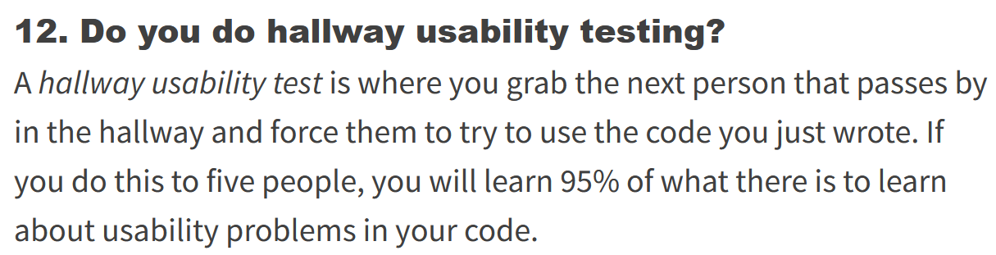
https://www.joelonsoftware.com/2000/08/09/the-joel-test-12-steps-to-better-code/

Slide 33
https://www.joelonsoftware.com/2000/08/09/the-joel-test-12-steps-to-better-code/
This is not made up but is actually the number
https://www.nngroup.com/articles/why-you-only-need-to-test-with-5-users/

Slide 34
The Demo commandments
Thou shall always start with the actual demo
Thou shall rarely discuss the process with the client
Thou shall always show thy sprint goals in terms the present stakeholder understandeth
When the question “Are there any questions?” need be asked, thy demo was bad
Thou shall always repeat thy collected feedback to validate it

Slide 35
Just do it
Demo done? Time’s over?
Repeat the collected feedback concisely to everyone present
Check if you missed anything
→ Someone should collect the feedback!

Slide 36
Sprint demo
Focus on the product
Show only three things:
The product itself
Choices you have made and would like to validate
Choices that you cannot make and would like to discuss
How can you show those choices best?

Slide 37
https://www.youtube.com/watch?v=as9IYFrTiKc

Slide 38
Questions?

Slide 39


